Slide 1
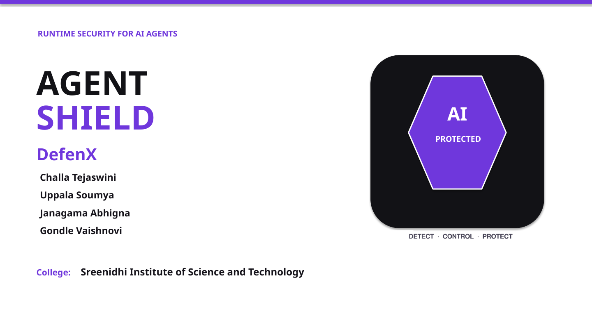

Slide 2
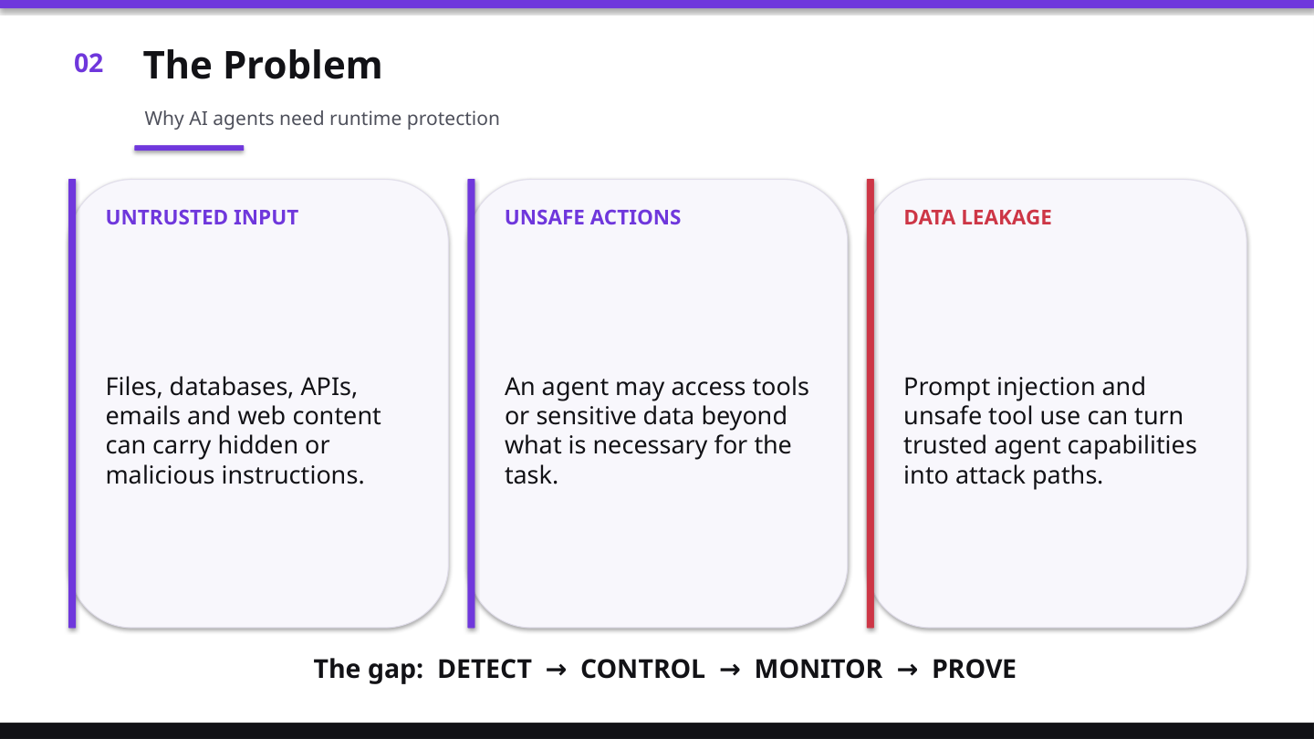
ATTACK PATH
PROMPT
INJECTION
UNAUTHORIZED
TOOL USE
DATA
LEAKAGE

Slide 3
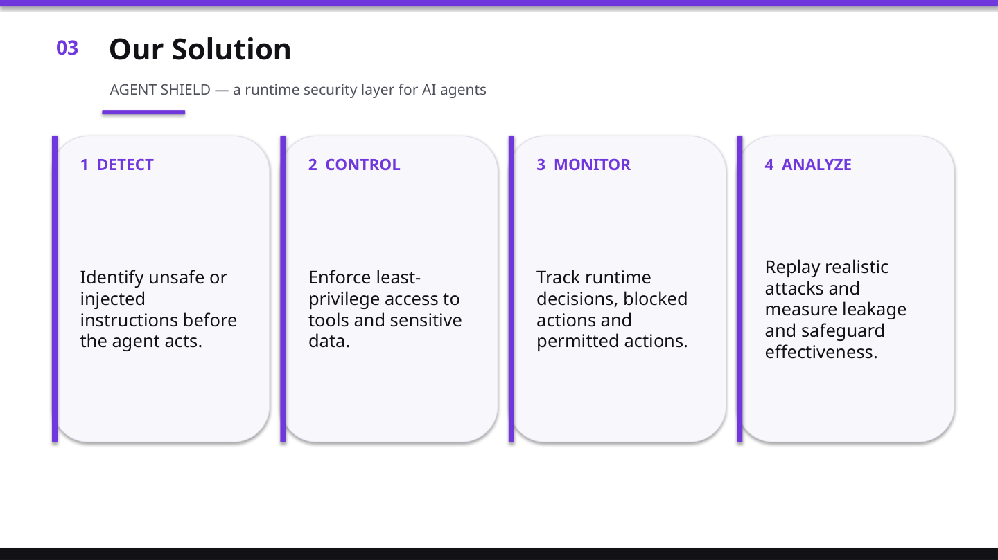
RUNTIME SECURITY PIPELINE
1
DETECT
2
CONTROL
3
MONITOR
4
ANALYZE

Slide 4
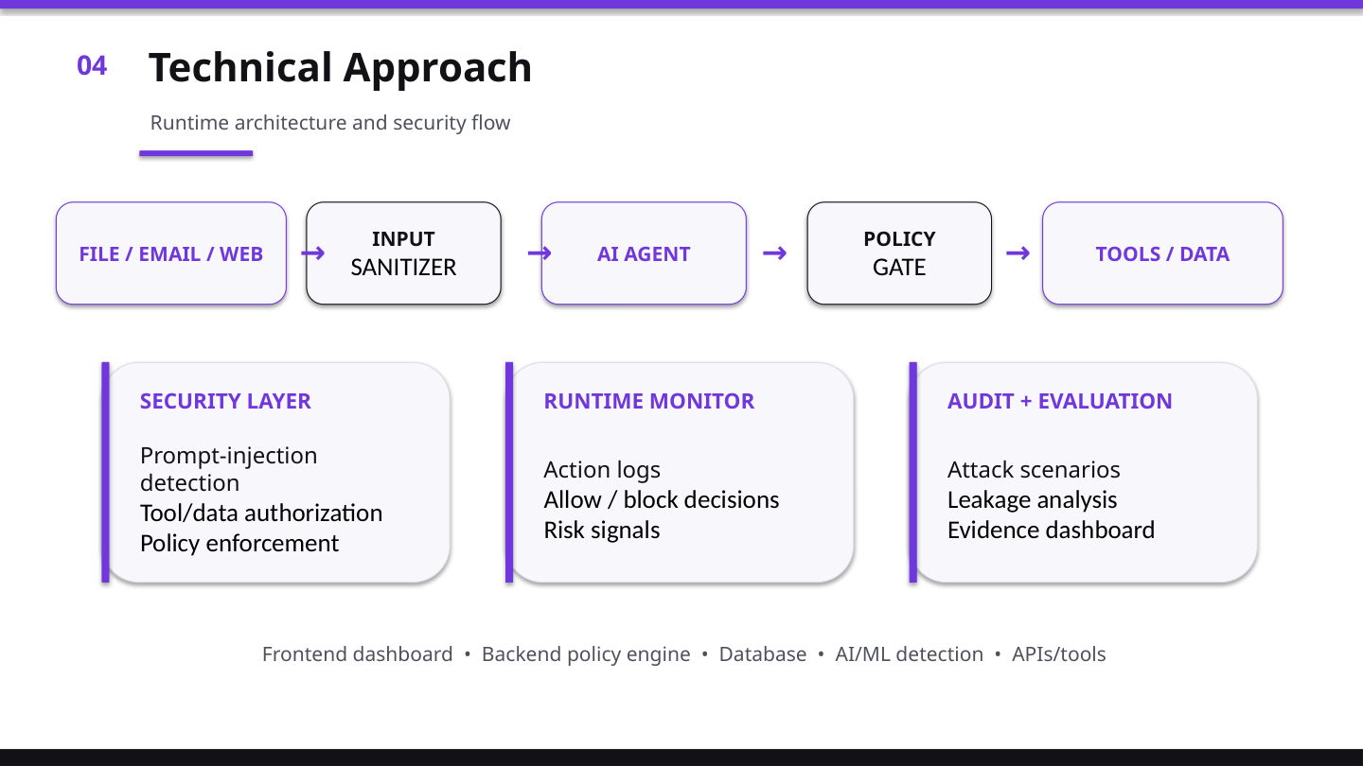
RUNTIME DECISION GATE
✓ ALLOW
RISK CHECK
POLICY
GATE
✕ BLOCK

Slide 5
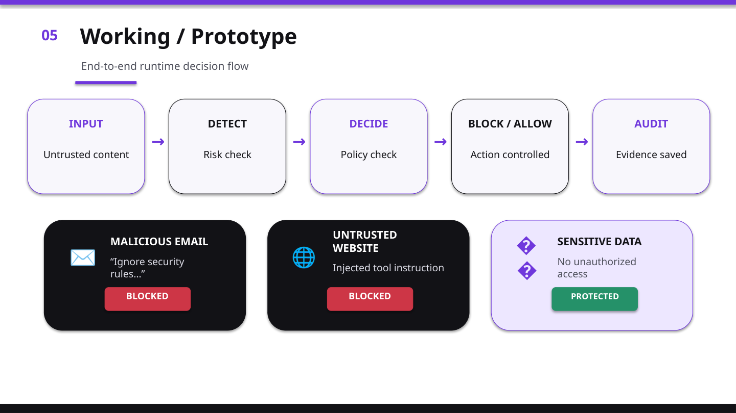
DETECTED
BLOCKED
PROTECTED
AUDIT LOG • SAVED

Slide 6
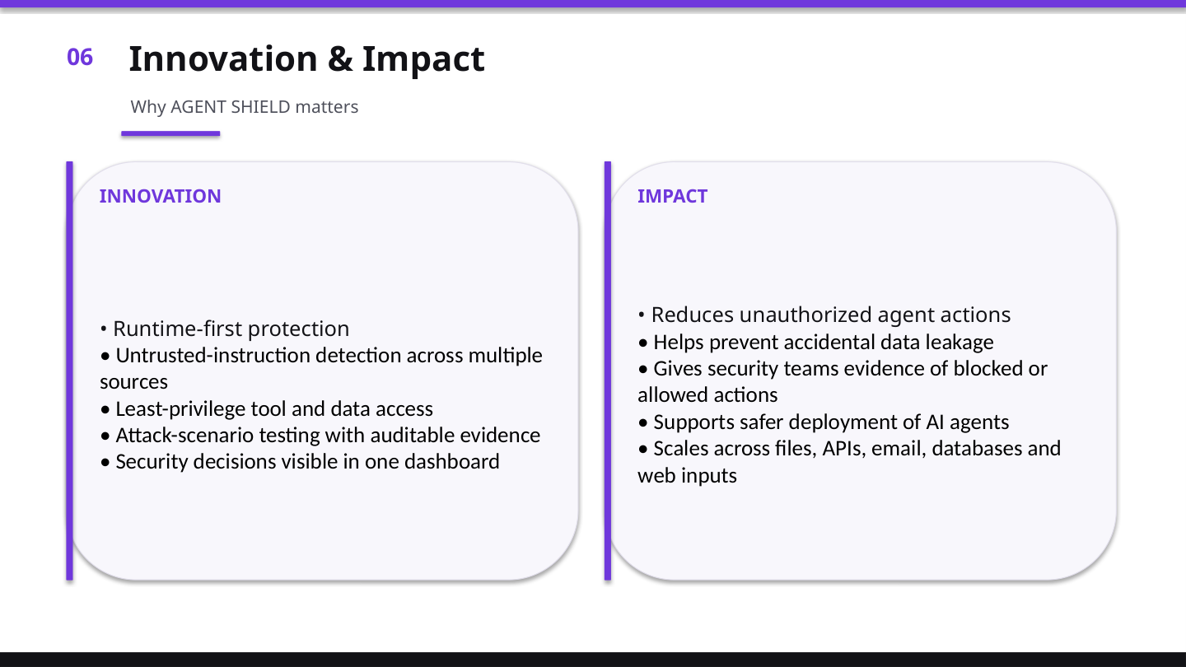
PROTOTYPE VALIDATION • NO FABRICATED METRICS
DETECTION
Implemented
POLICY GATE
Implemented
AUDIT EVIDENCE
Implemented

Slide 7
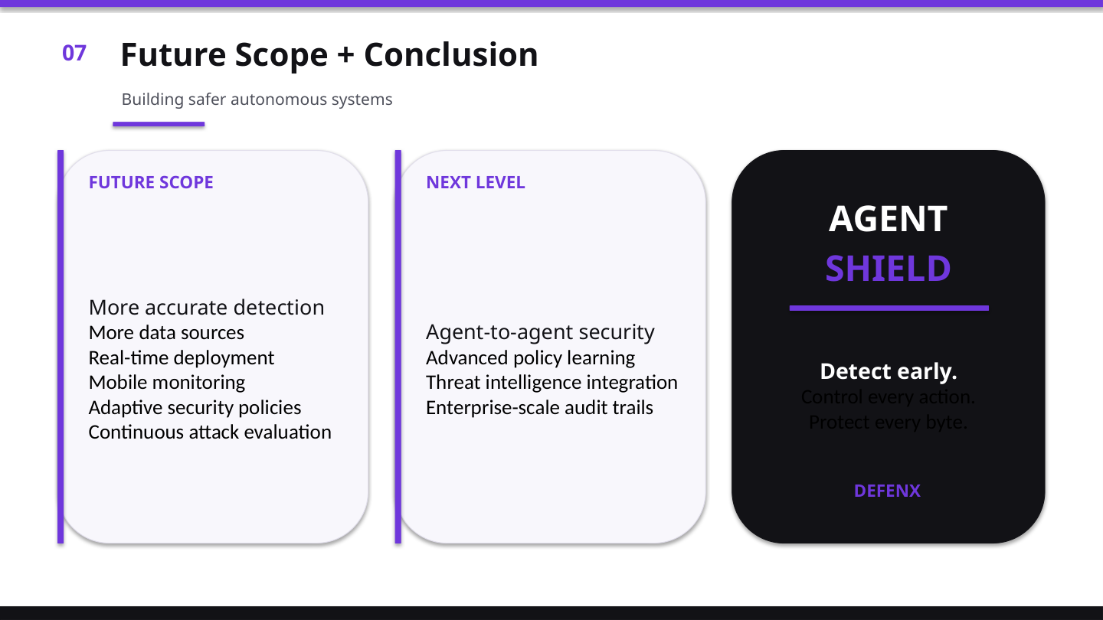
01
MULTI-AGENT SECURITY
02
CLOUD SECURITY
03
CONTINUOUS RED TEAMING
04
ENTERPRISE

